Slide 1
FireAware: Community Based
Wildfire Awareness
Tewodros Ambaw, Raja Marthala, Tapio Luukkonen, Adeel Arif

Slide 2
Introduction
Wildfires and natural resource management have become increasingly critical challenges in today's world, with climate change contributing to more frequent and severe fire events.
To address these challenges, innovative solutions that leverage technology and publicly available data are essential.
Local communities living in fire-prone areas often face unique risks, and empowering them with tools to report, monitor, and manage fires and natural resources is crucial for their safety and the preservation of ecosystems.

Slide 3
Our Solution
Our team created a solution for fire management and prediction of wildfire using machine learning/AI techniques and make communities to be aware via different channels.
Our solution idea is to get active wildfire as well as predict future happenings using information from different sources. One source is satellites that gives as active fire information. We also forecast/predict using Machine learning the possible happening of wildfire. We also collect wildfire occurrence inputs from communities around the are via mobile app. Communities can get incentives for being alert and report verifiable wildfire entries.
We developed a proto type of the mobile app in which people get a satellite image of the fire coverage that is overlaid by our ML algorithm. Authorities and community will be informed about the possible recommended actions. The authorities will also communicate to the public using e.g. radio communications in areas where there are no internet connections.

Slide 4
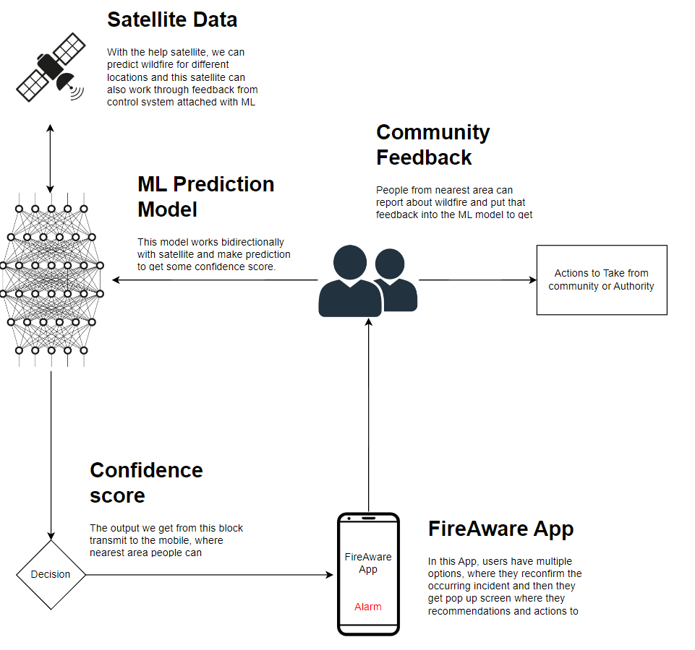
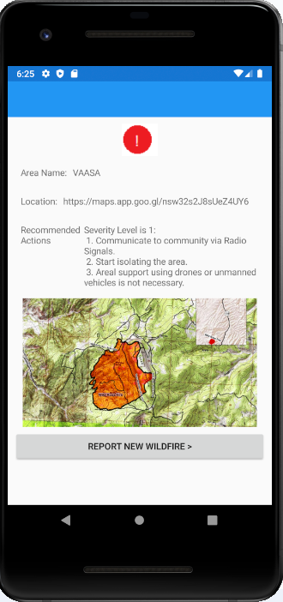
Proposed Solution with App Screenshots:
Screenshot: MobileApp showing processed satellite image and alert people with toggling alarm and showing wildfires area coverage provided by the ML algorithm

Slide 5
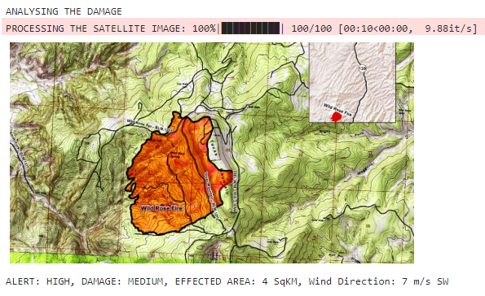
Recommendations for Evacuation
Possible recommendations for different fire severity levels.
Low Severity Fire → Preventive Evacuation
Moderate Severity Fire → Voluntary Evacuation
High Severity Fire → Mandatory Evacuation
Extreme Severity Fire → Life-Threatening
Example:
If the forest is very dense in an area where water is no more, then this extremely severe fire, from there you should leave the place as soon as possible.
Image: Our AI/Machine Learning Algorithm processing satellite image for wild fire

Slide 6
Actions Needed from Agencies:
Example case Study:
For a Forested area, when there is no place to get out from fire:
Communication (Internet, Radio Signals)
Monitoring and Response
Thermal Imaging Drones and aerial support e.g helicopters
Deployment of Ground crews
Establish some Safe Zones

Slide 7
Future Aspects:
Plans to expand this solution to remote areas where internet is not available
Encouraging communities to be more active in contributing.
Providing incentives for the active observers
References
yearly summary by country - Finland
NFPA 1: Fire Code
Fire Prevention and Community Risk Reduction (fema.gov)
https://en.ilmatieteenlaitos.fi/open-data-manual

